Slide 1
Minimizing latency of critical traffic through SDN
Author: Joan Meseguer Llopis
Publisher/Conference: IEEE NAS 2016
Presenter: Cheng-Feng Ke
Date: 2016/11/02
Department of Computer Science and Information Engineering
National Cheng Kung University, Taiwan R.O.C.
Notes:
1
如何透過 SDN 最小化延遲重要資料的傳輸

Slide 2
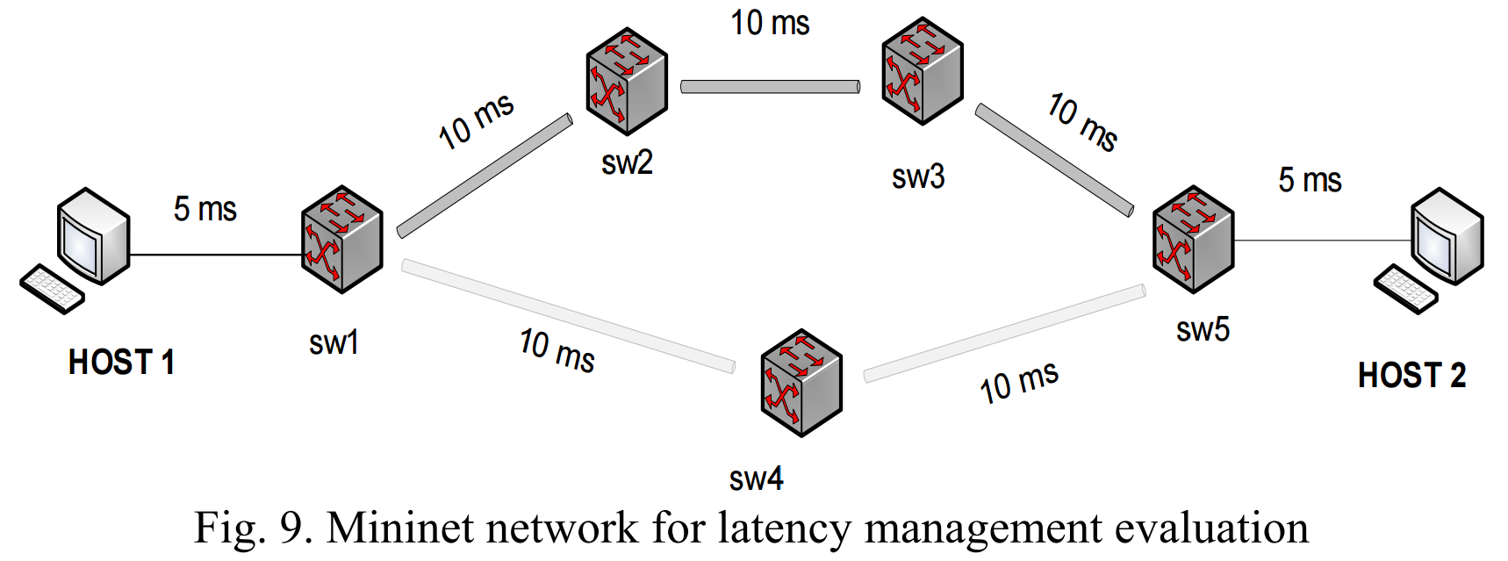
Introduction
The presented solution analyzes available network paths and dynamically calculates delay associated with the paths. Network management system redirects the traffic to the path with minimal delay.

Slide 3
Introduction
In practice the most simple and effective approach to mitigate negative consequences of traffic growth is providing overestimated network capacity.
But for some IoT services such solutions are not sufficient.
A doctor in a remote location or detection of a car accident. Both require higher video quality and minimal latency.
If such situation happens, data become critical for a certain period of time, during which they need to be managed with special treatment.

Slide 4
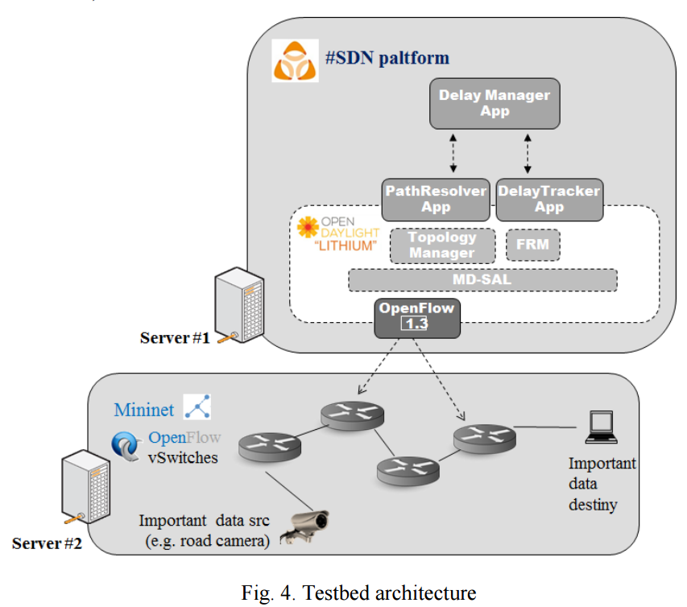
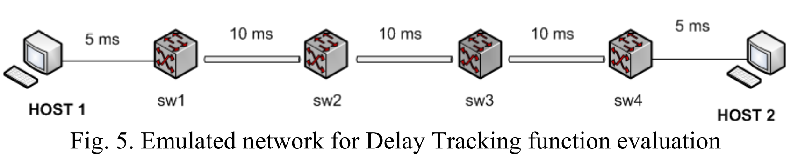
Introduction
Delay Manager function
Path Resolver function
Delay Tracker function

Slide 5
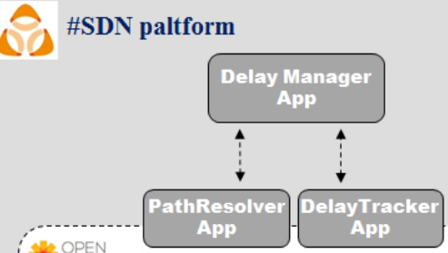
Introduction
Path Resolving and Delay Tracking functions run in parallel and they are merely responsible for monitoring activities.
On top of them the Delay Management function consumes the monitored information for analysis and control activities.

Slide 6
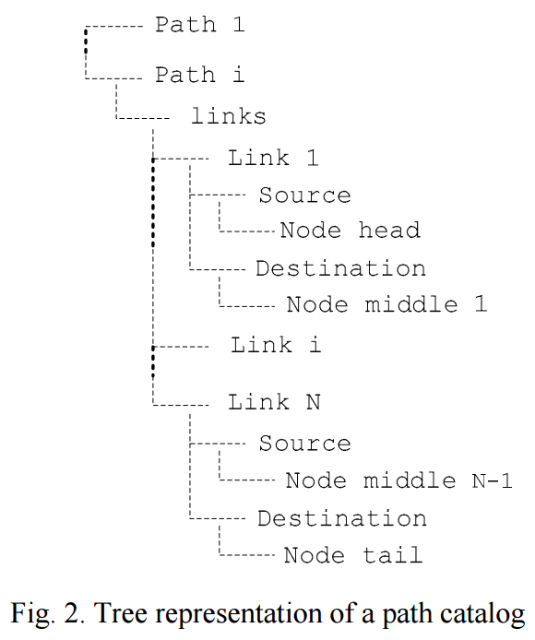
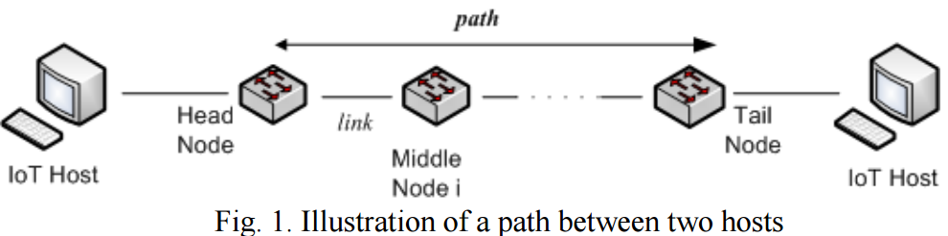
Path Resolving
The algorithm used for computing paths, that connect the pair of hosts, follows a brute-force search approach that is only capable to discover paths in networks with a ring-like topology.

Slide 7
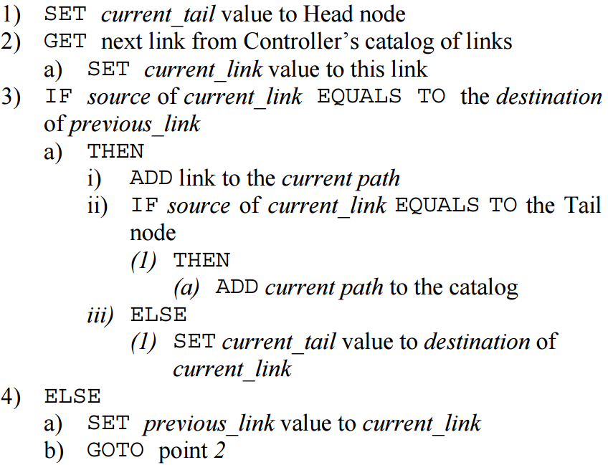
Path Resolving

Slide 8

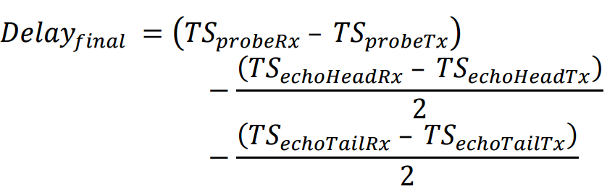

Delay Tracker
This function aims to measure the
(near) real-time latency of network paths.
Probe Packet : Controller – Switches – Controller
Echo Packet : Controller - Switch
Probe
Echo

Slide 9
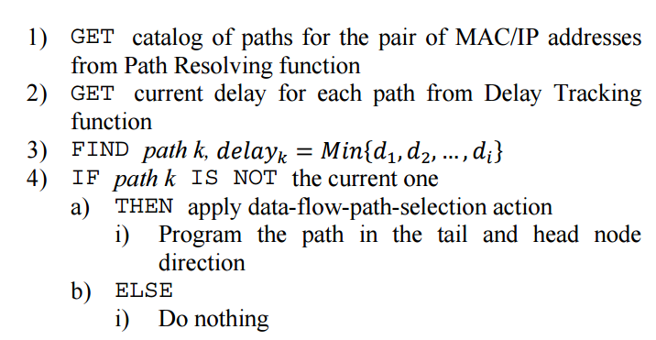
Delay Manager
Logic of Delay Management basically performs a delay sensitive routing, which means that it makes (near) real time decisions to select the most appropriate path among the available ones that will keep the latency as low as possible.

Slide 10
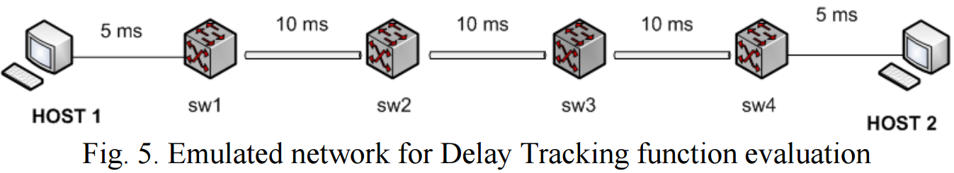
Evalution 1
The tests performed to evaluate the Delay Tracking function.
The final end-to-end nominal latency for the path SW1-SW2-SW3-SW4 this would be 30 ms.
The physical latency of link SW2- SW3 suffers from random changes throughout the simulation runtime.
Compare it to the Ping utility from terminal H1 to H2.

Slide 11
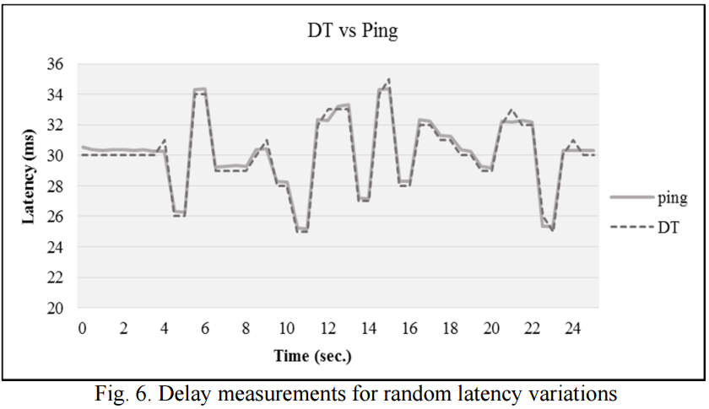
Evalution 1
Notes:
maximum deviation of DT’s measurements from the nominal value and from the ping tool is 1 ms and 1.35 ms respectively.

Slide 12
Evalution 2
The tests performed to evaluate the Delay Tracking function.
In the second one, the latency is deterministic.
The applied variations to that link are 30 ms of magnitude following a harmonic pattern with a progressive period decrease.

Slide 13
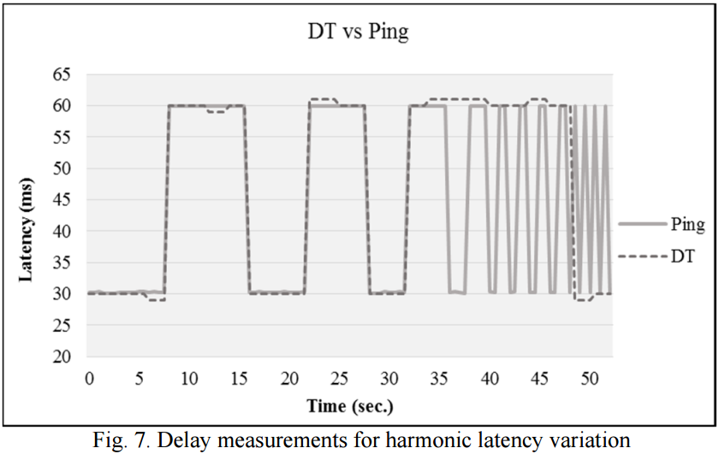
Evalution 2

Slide 14
Evalution 3
Besides the comparison of DT and ping mechanisms we considered worthy to analyze the latency of the control channel (i.e. controller’s southbound interface).
Round-triptime (i.e. echo_packet_RTT) of echo packets.
One-way-trip-time of the probe packet (i.e. probe_OWTT).
Notes:
Round-triptime 往返時間
One-way-trip-time 單程旅行時間

Slide 15
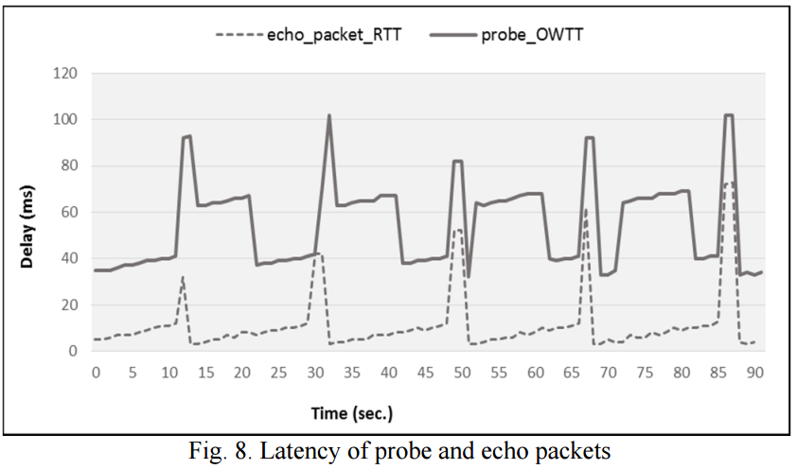
Evalution 2
Round-triptime (echo_packet_RTT).
One-way-trip-time (probe_OWTT).

Slide 16
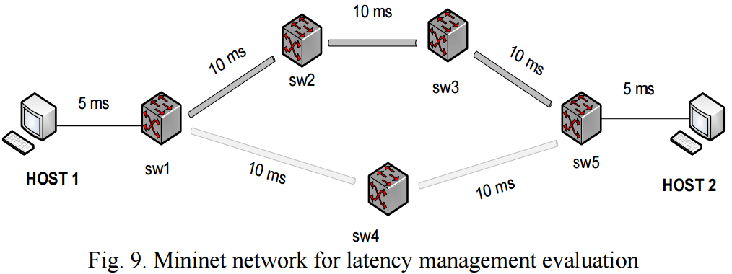
Evalution 4
We compare the measured delay for the flow between HOST 1 and HOST 2 when the DM module is activated against when it is deactivated (Shortest path based routing).
Shots of 60 seconds long have been launched.
The latency variations are applied to the link that connects SW1 with SW4.

Slide 17
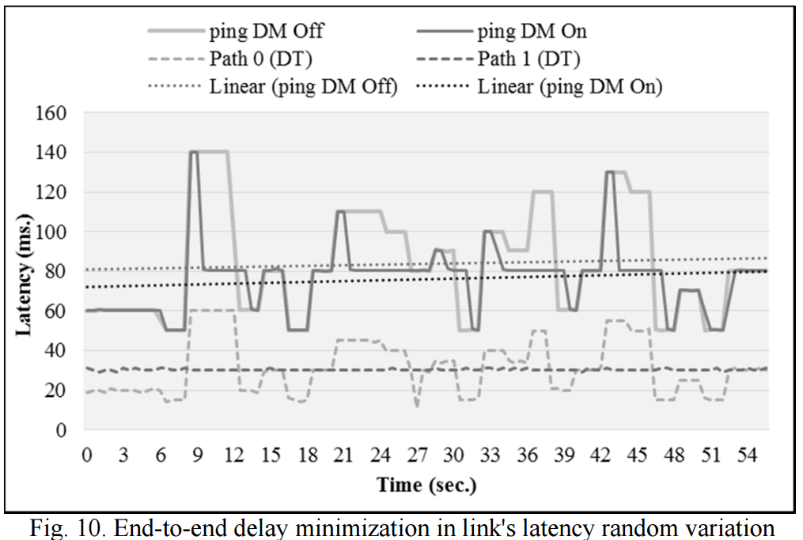
Evalution 4

Slide 18
Evalution 5
Shots of 60 seconds long have been launched.
The applied variations to that link are 100 ms of magnitude following a harmonic pattern.

Slide 19
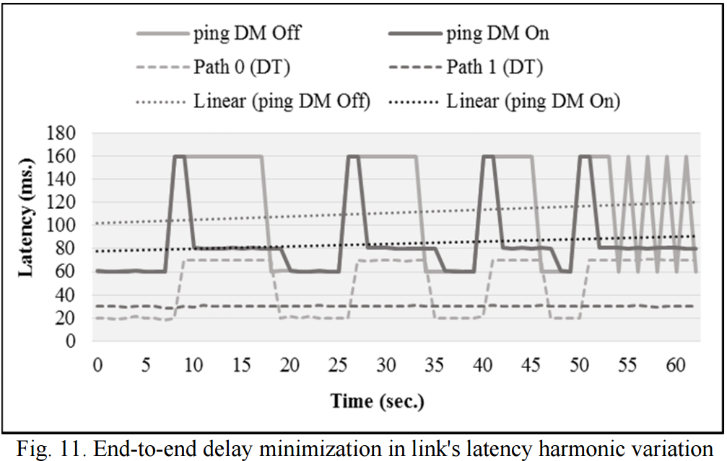
Evalution 5

Slide 20
Conclusions
Our solution is able to discover changes in topology and path delays and to redirect the traffic to minimize end-to-end delay between nodes.
Reduce the latency by 63.1 % comparing to shortest path based routing, which is typically based on number of hops.
We observed that in fast variations, which may lead to wrong forwarding decisions. Increasing the sampling frequency may be a potential solution.

